Slide 1
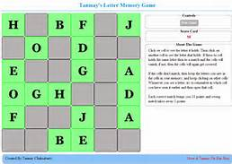
Memory Game
BY Cole Trammer

Slide 2
The Memory Game
This is a one person game where the objective is to beat your own score
You have to match the tiles in as few moves
as possible

Slide 3
How to WIN
The best way to play is to go in order
So you go 1 – 36 unless you see a match
This lets you see all of the tiles, and is usually a better strategy than just randomly guessing

Slide 4
Stuff I Learned
Learned about import random(random.shuffle)
Learned about dictionary key errors
Learned how to format dictionaries in a grid
Learned about buttons in Tkinter

Slide 5
Method for Implementation
I used for loops to build the dictionaries to store the board state and the goal for the user to achieve
Used random.[functions] to set up a board
Game logic takes to numbers and sees if their respective indexes are == to each other
Uses While True: to stop false inputs that cannot be made

Slide 6
CONT.
The next thing for me to do was to prevent errors
I did this by checking if the new index was already picked or matched
I store choice1 so my if statements would work
Implemented a score counter and a game counter so you can play as many games as you want

Slide 7
Problems
Key Error: 0
Displaying dictionaries
Tkinter
Stopping BUGS

Slide 8
CODE!!! And QUESTIONS???

